Slide 1
Plus FCE Letter of Complaint
pp62-68

Slide 2
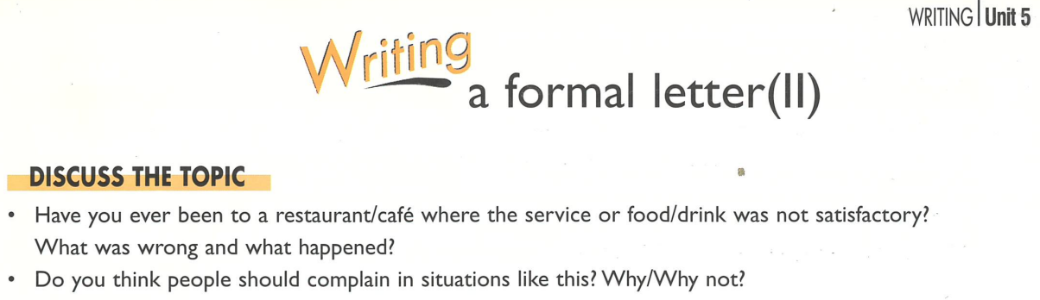

Slide 3
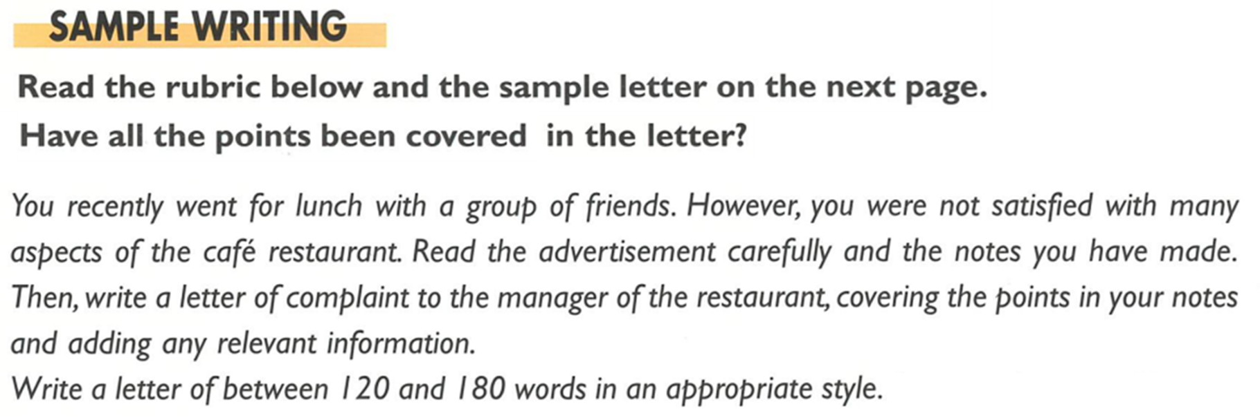

Slide 4
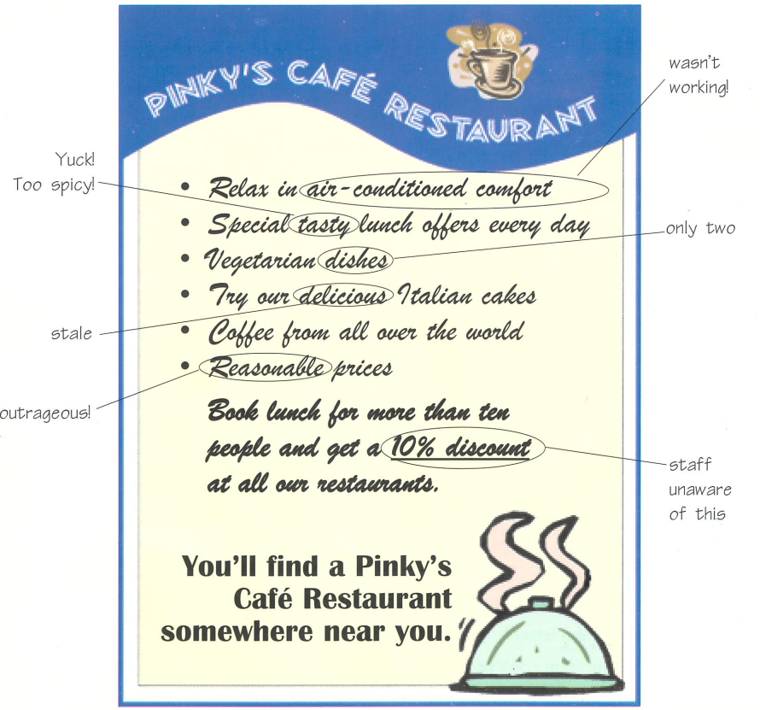

Slide 5
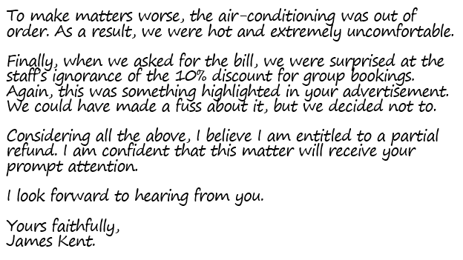
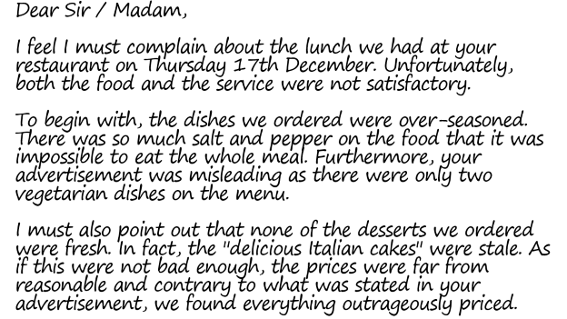
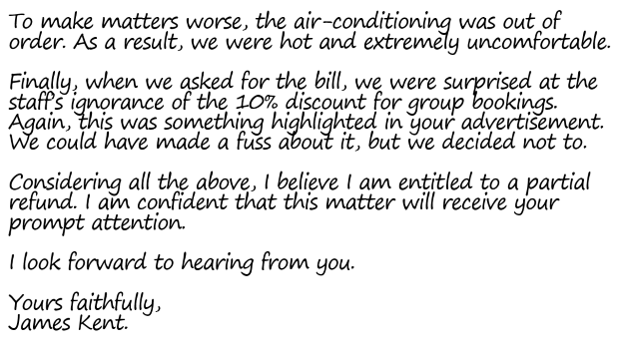
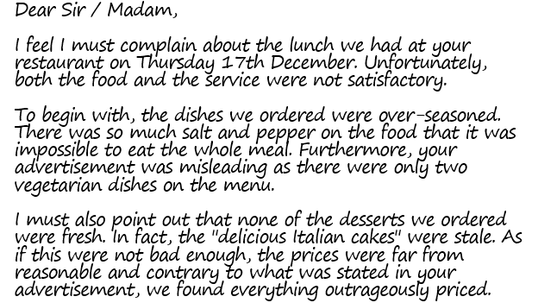

Slide 6
Dear Sir / Madam,
I feel I must complain about the lunch we had at your restaurant on Thursday 17th December. Unfortunately, both the food and the service were not satisfactory.
To begin with, the dishes we ordered were over-seasoned. There was so much salt and pepper on the food that it was impossible to eat the whole meal. Furthermore, your advertisement was misleading as there were only two vegetarian dishes on the menu.
I must also point out that none of the desserts we ordered were fresh. In fact, the "delicious Italian cakes" were stale. As if this were not bad enough, the prices were far from reasonable and contrary to what was stated in your advertisement, we found everything outrageously priced.

Slide 7
To make matters worse, the air-conditioning was out of order. As a result, we were hot and extremely uncomfortable.
Finally, when we asked for the bill, we were surprised at the staff’s ignorance of the 10% discount for group bookings. Again, this was something highlighted in your advertisement. We could have made a fuss about it, but we decided not to.
Considering all the above, I believe I am entitled to a partial refund. I am confident that this matter will receive your prompt attention.
I look forward to hearing from you.
Yours faithfully, James Kent.

Slide 8
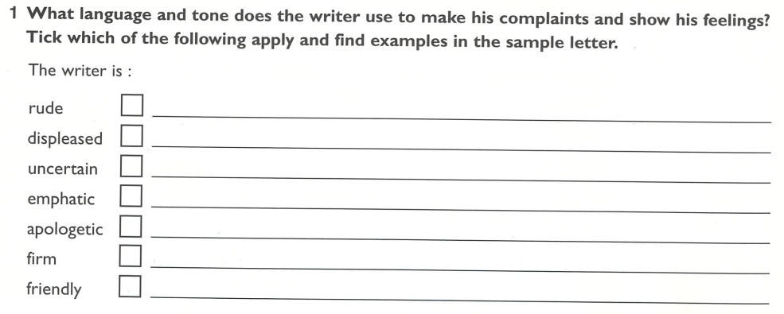
O
P
I feel I must complain . . .
O
P
if this were not bad enough, . . .
O
P
Considering all the above, I believe I am entitled to a partial refund.
O

Slide 9
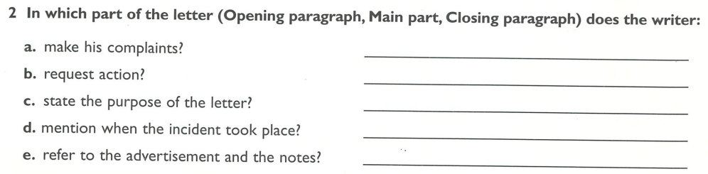

Main part.
Closing paragraph.
Opening paragraph.
Opening paragraph.
Main part.

Slide 10

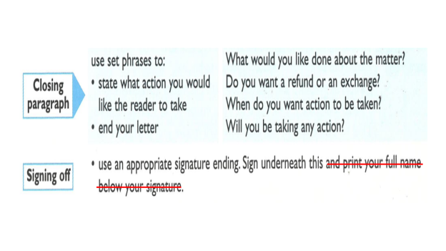
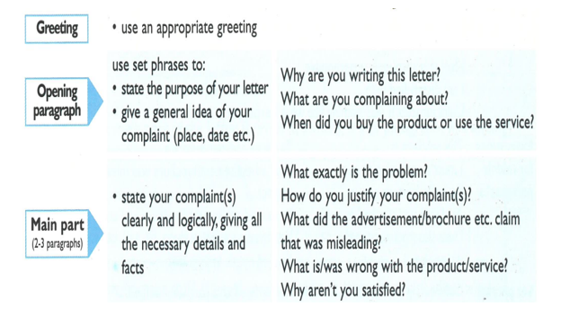
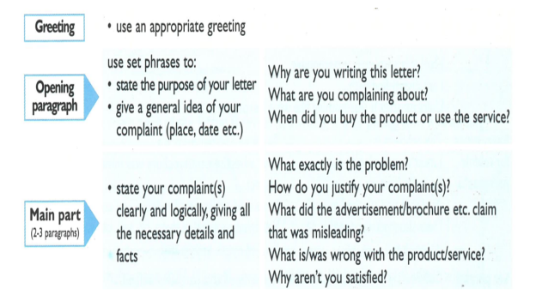
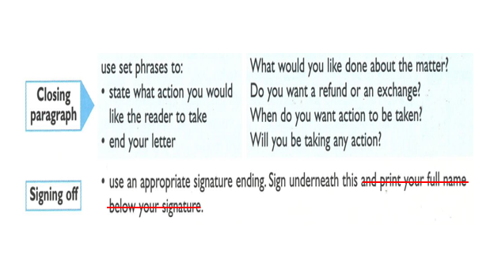

Slide 11
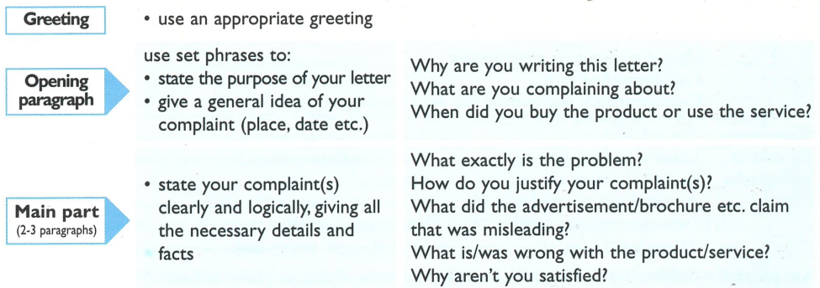

Slide 12
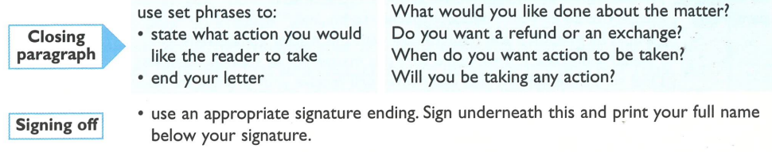

Slide 13
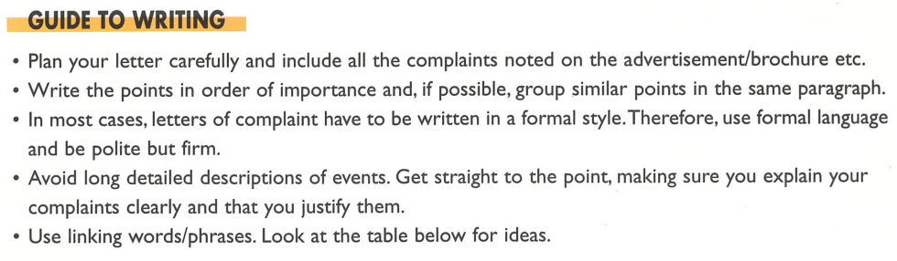

Slide 14
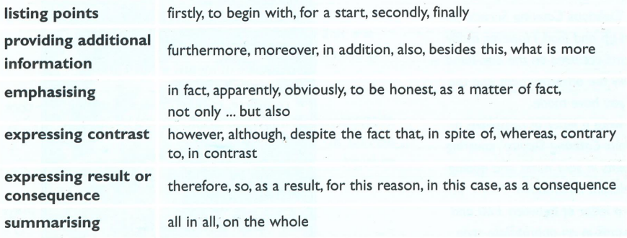
📃
➕
🔨
☯️
⸫

Slide 15
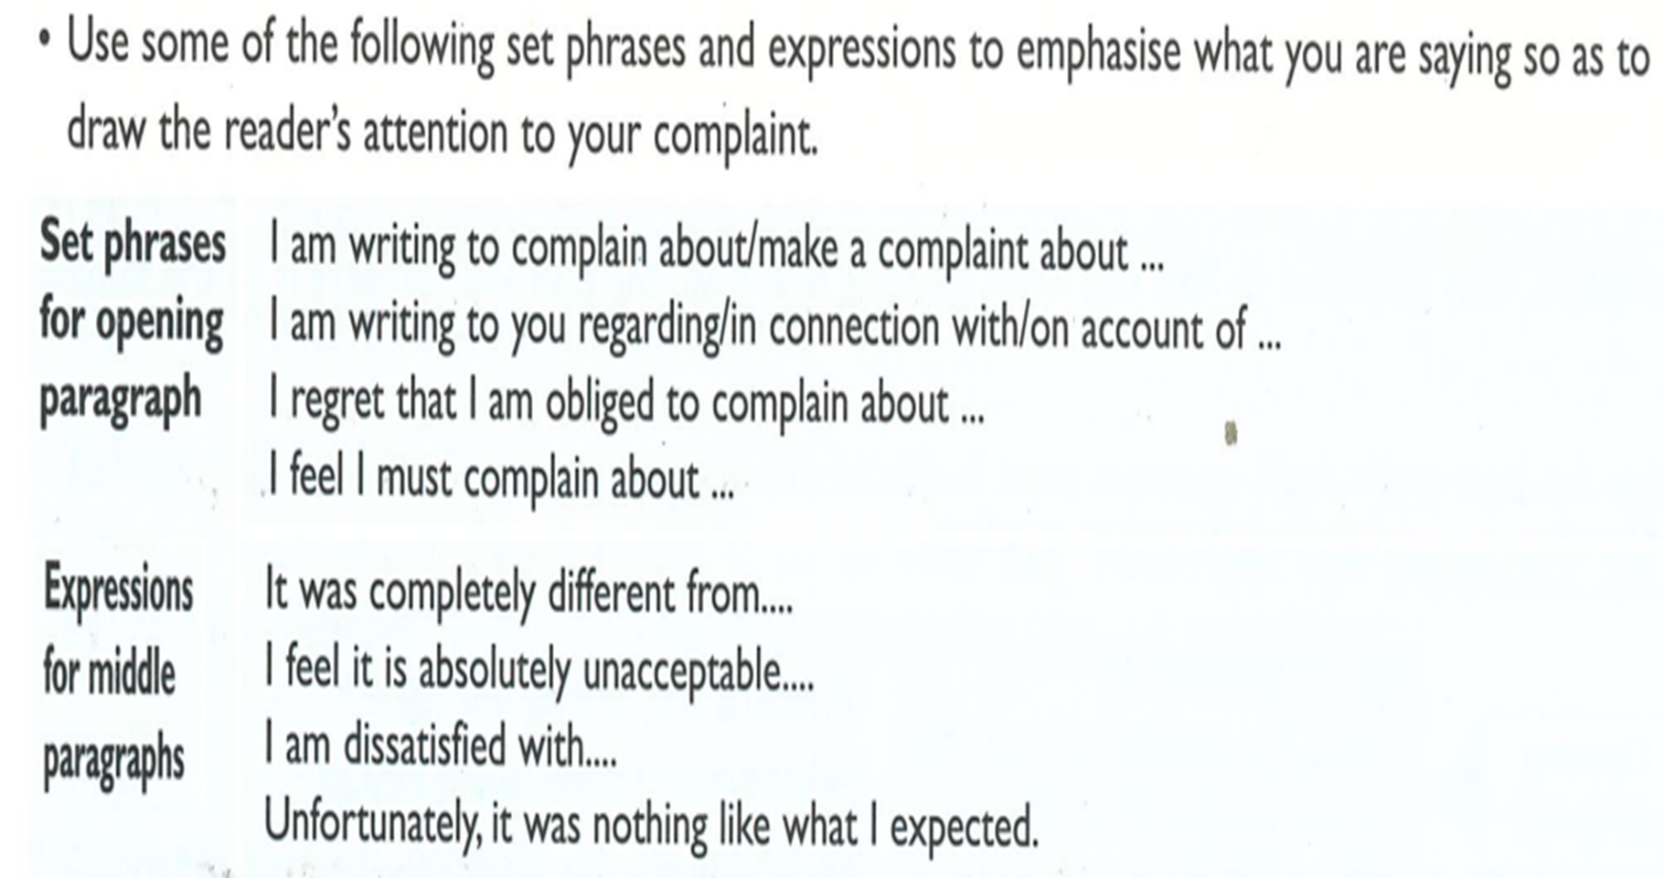

Slide 16
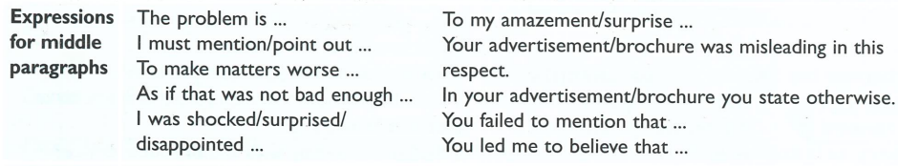

Slide 17
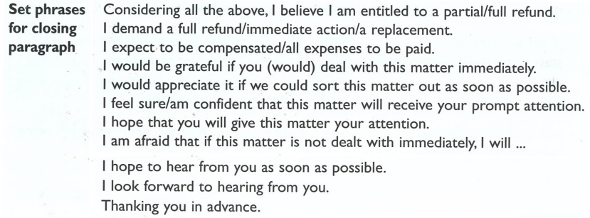

Slide 18
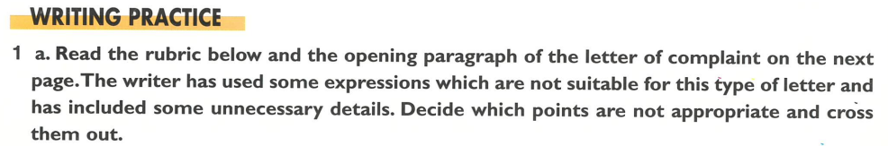

Slide 19
You were president of a committee responsible for organising your school's end-of-year dance. The committee chose Delicious Catering Service for the set-up and food. However, many problems occurred on the day. Read carefully the advertisement and the notes you have made. Then write a letter of complaint to Delicious Catering Service, covering the points in your notes and adding any relevant information.
Write an email of between 120 and 180 words in an appropriate style.

Slide 20
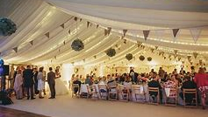
A marquee

Slide 21
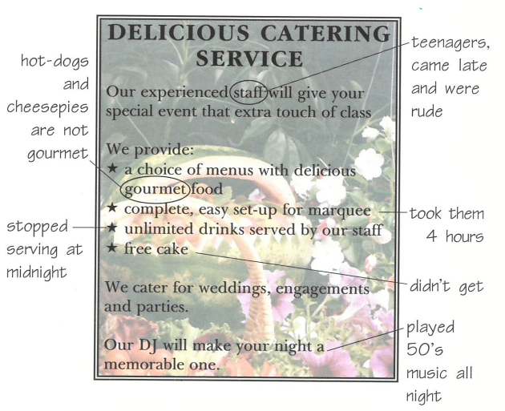

Slide 22
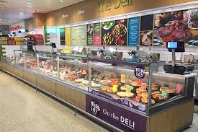

Slide 23
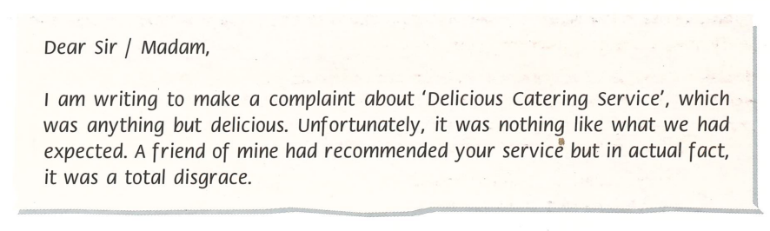

Slide 24
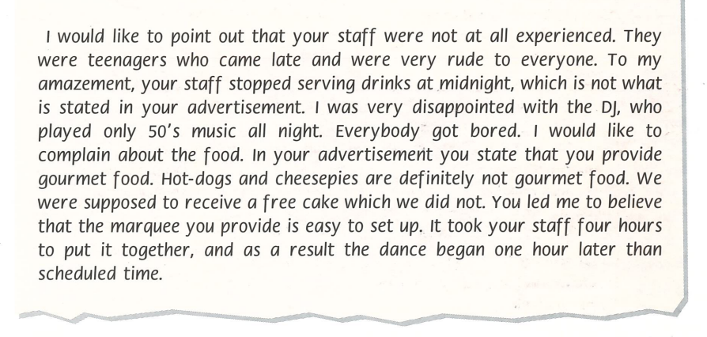

Slide 25
Possible Answer
To begin with, I would like to point out that your staff were not at all experienced. As a matter of fact, they were teenagers who came late and were very rude to everyone. Furthermore, to my amazement, your staff stopped serving drinks at midnight, which is not what is stated in your advertisement.
I was also very disappointed with the DJ, who played only 50's music all night. As a result, everybody got bored. Furthermore, I would like to complain about the food.
If this were not enough, in your advertisement, you state that you provide gourmet food. However, hot-dogs and cheese pies are definitely not gourmet food. We were also supposed to receive a free cake which we did not.
Finally, you led me to believe that the marquee you provide is easy to set up. Nevertheless, it took your staff four hours to put it together, and as a result the dance began one hour later than the scheduled time.

Slide 26
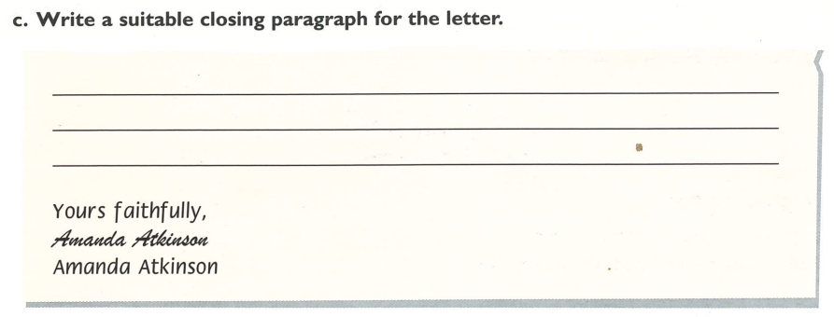
Considering all the above, I believe I am entitled to a partial refund. I am confident that this matter will receive your prompt attention.
I look forward to hearing from you.

Slide 27
You saw this advertisement in a newspaper and decided to try the diet However, one month later you are not satisfied with the results and have realised that the advertisement was misleading.
Read the advertisement and the notes you have made. Then, write a letter of complaint to the company which advertised the diet, covering the points in your notes and adding any relevant information.
Write an email of between 120 and 180 words in an appropriate style.

Slide 28


Slide 29
3 Task for homework.
Write the email of complaint using the plan you made in exercise 2.

